Slide 1
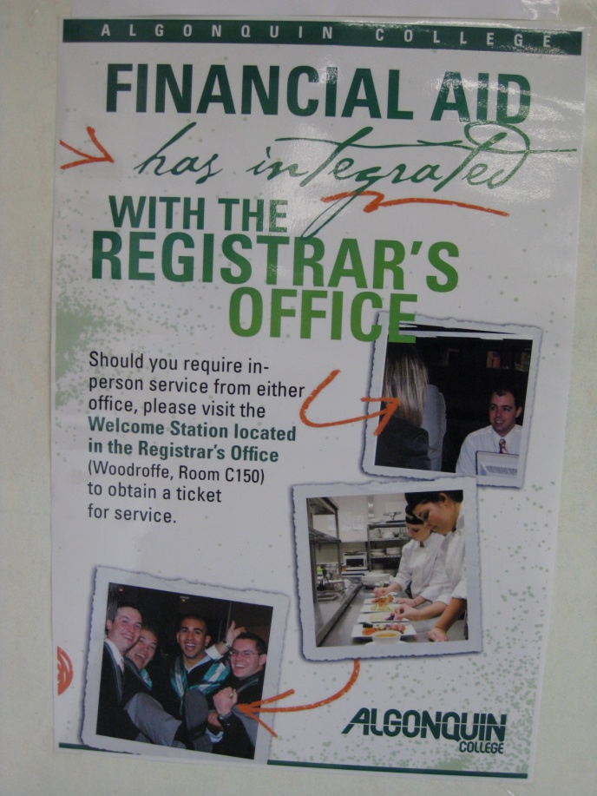
Financial Aid
A how-to guide by William Collins, André D’Aoust, Ivan Belov & Marcio Da Silva

Slide 2
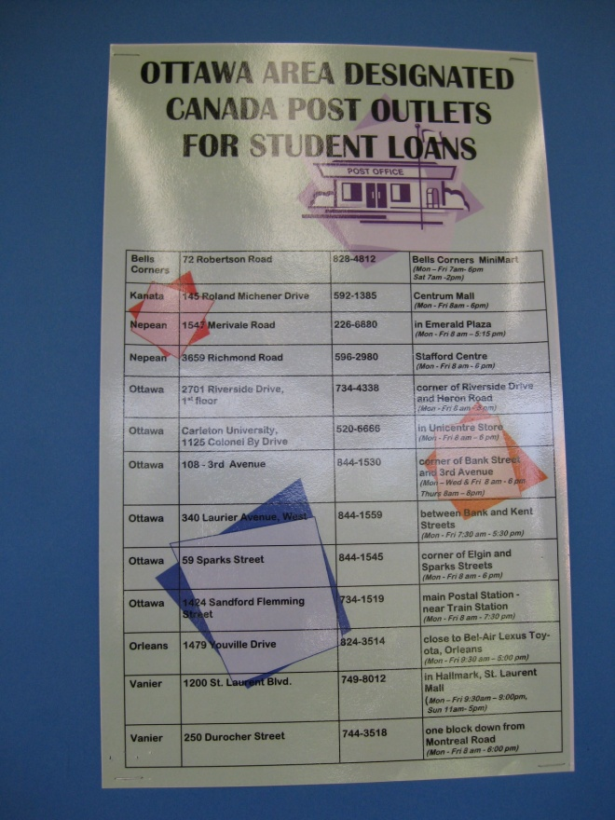
Overview
What is Financial Aid?
Why Visit the Financial Aid Office?
Where is the Financial Aid Office?
Where to Begin
Discover Your Options
Important Information

Slide 3
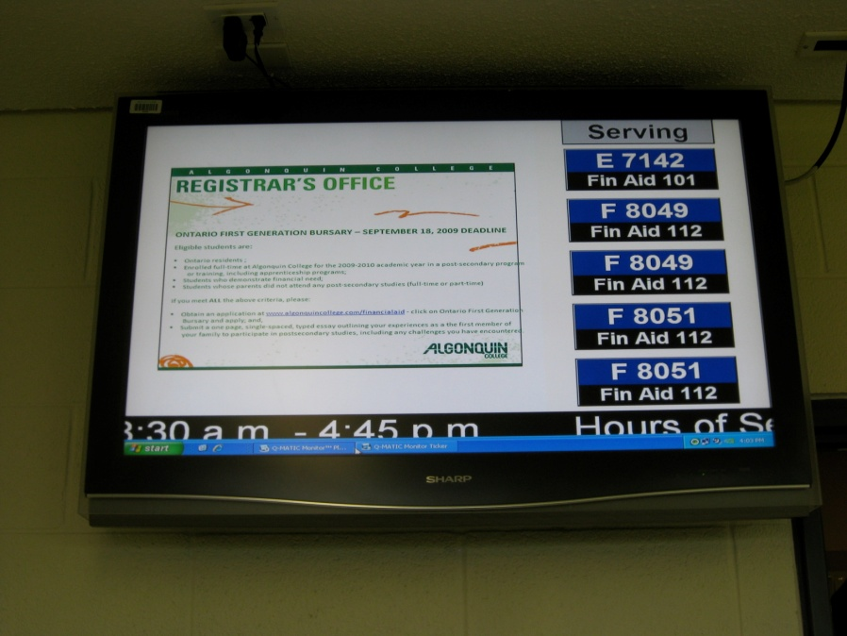
What is the Financial Aid Office?
The Financial Aid Office offers services that provide students with ways of paying for tuition and the necessities associated with college life, such as food, clothing, shelter, and of course, books.

Slide 4
Why Visit the Financial Aid Office?
The financial aid office is THERE TO HELP YOU!!
They offer many programs to help assist you as a student, including:
Government Assistance Programs (OSAP)
Bursaries
Part-Time Student Loans/Grants
Cash Advances
Tuition Fee Deferments
Scholarships and Awards
Campus Employment Opportunities

Slide 5
Where is the Financial Aid Office?
To get to the Financial Aid Office, you must undergo a series of crucial, and impossible tasks of endurance and strength.
1 – Obtain a ticket at the registrars office
Located at the main entrance of building C
2- Wait outside of the Financial Aid Office
Located on the second floor C building; room C225.
3- Enter the Financial Aid Office when your number is displayed on either TV screen located above room C225.
NOTE – Enter the correct booth displayed on the TV!!

Slide 6
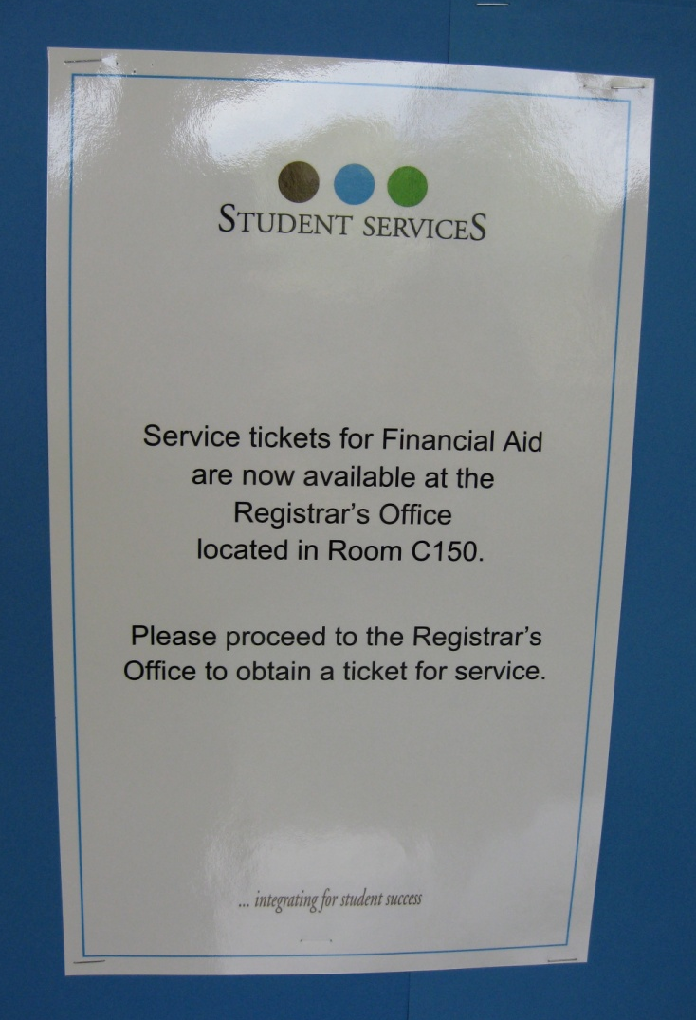
Where to Begin
Things you should have ready, regardless of what you are looking for:
Government Issued S.I.N. Card
Government Issued Photo I.D.
Student Card
Call Ticket
Any documentation required for the service you request.
(Ex. Void Check,)

Slide 7
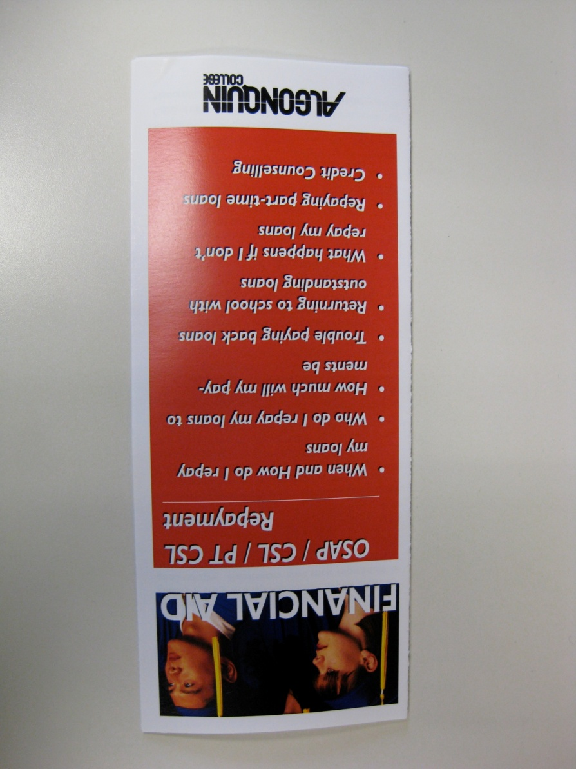
Discover Your Options
Advantages to Living on a Budget
Offers examples on how to save money and discover more Algonquin College services aimed to help you
OSAP/CSL/PT CSL & Repayment
Insight on methods to obtain government funding assistance and how to repay them
General Financial Aid
General financial aid information such as office hours, explanations and deadlines.

Slide 8
Important Information
Hours of operation:
September 8th to 18th : Mon-Thurs 8:30 to 19:30, Friday 8:30 to 16:45
Regular Fall & Winter: Mon-Friday 8:30 to 16:45
Summer: Mon-Friday 8:00 to 16:00
Website: www.algonquincollege.com/financialaid
Email: financialaid@algonquincollege.com
Telephone: (613) 727-4723 ext. 7678
Cost of service: free

